Slide 1

4.3.1., 4.4.1., & 4.5.1. Intro Video: Globalization, Convergence, & Underdevelopment
Three major themes:
4.3. Globalization not a one-way ratchet
4.4. Failure of economies to “converge”
4.5. Manufacturing as the path to a community of engineering practice
  1870-1914 globalization pushing the Global South off of that path
<>
<>
2020-12-06
Notes:
This week we are picking up the pace. If we continued at our former pace, we would have spent last week doing American exceptionalism and this week doing plutocracy and inequality. That would have left globalization for the first week after spring break, the convergence – or rather, the lack of convergence of economies — for the second week, and the development of under development for the third week after spring vacation. Then we would've had one week to do one more unit, and it would've been time to review and bring the semester to a close.
But I want to do more, and I think we can. Last week we did two units: hegemony and plutocracy, and I think it went well. So this week we do three. To lighten the load, there will be no quiz this week…

Slide 2
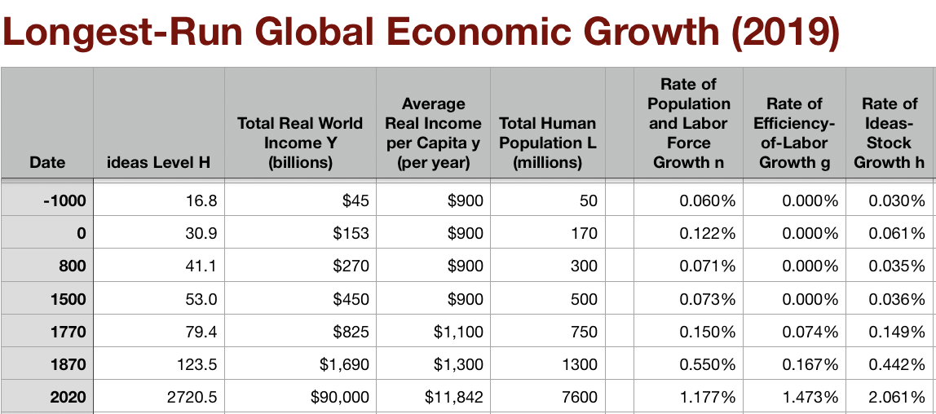
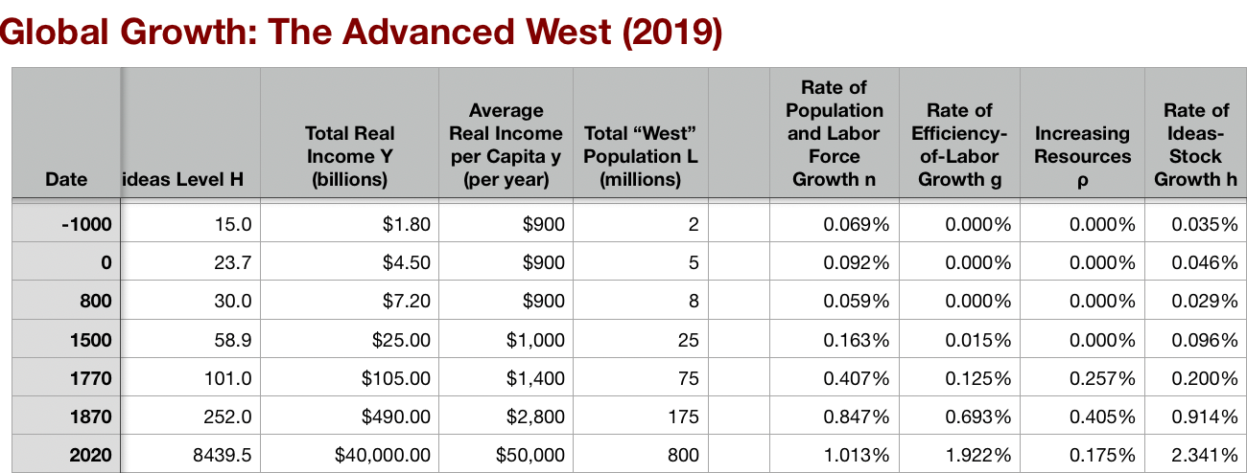
4.3.1. Globalization Advances and Retreats
In historical perspective:
Early modern European navies and trading fleets
How did they shape industrial development?
It is agreed:
  catastrophes for west Africa
  catastrophes for the Amerindians
  catastrophe (long term) for Moghul and other Indian elites that did not ally with the British.
But how much did pre-industrial trade and plunder affect European development? That is not so clear.
A key link: sugar
A key link: cotton
  George Washington in the 1790s: 1/4 of wealth upon your death,
  For Jefferson Davis it wasn’t his land but rather his slaves that were three-quarters of his wealth
    And so the U.S. Civil War of 1861-5 came.
Early-nineteenth century cotton showed what late-eighteenth century sugar had prefigured:
Long-distance transoceanic trade could matter not just for the consumption pattern of an elite but for an economy, a polity, and a society as a whole.
This process was kicked up a notch, into much higher gear, come 1870.
Notes:
The extent to which the navies and trading fleets of the great European sea-borne empires of the sixteenth, seventeenth, and eighteenth centuries shaped the industrial development of western Europe has always been one of the most fiercely-debated and unsettled topics in economic history. European expansion in the sixteenth, seventeenth, and eighteenth centuries were catastrophes for the regions of west Africa that were the sources of the slave trade; for the Amerindians of the Caribbean; for the Aztecs, Incas, the mound-builders of the Mississippi valley; and for the princes of Bengal and others who found themselves competing with the British East India Company in the succession wars over the spoils of India’s Moghul Empire—that is not in dispute. But how much did pre-industrial trade and plunder affect European development? That is not so clear. However, we can say that with the coming of the Industrial Revolution era the world economy did become globalized, and trade between continents became a very important economic factor. First sugar, then cotton, and then after 1870 global trade in pretty much every stable staple commodity became a huge deal for how the world economy was to grow.

Slide 3
Export Share Doubling
World trade as a proportion of production:
What was it?
  It was perhaps 1.5% in 1500
  Rising to perhaps 3% by 1700
  By 1850, about 4%.
  In 1880 it was 11%
  By 1913 17%.
  (Today it is 30%.)
Between 1870 and 1913 exports as a share of national product doubled in India and in what was to become Indonesia
  And more than tripled in China.
  And in Japan—forced out of two and a half centuries of Tokugawa isolationism by U.S. gunboats—exports rose from practically zero to 7 percent of national product in only two pre-World War I generations.
Notes:
Between 1870 and 1913 exports as a share of national product doubled in India and in what was to become Indonesia, and more than tripled in China. And in Japan—forced out of two and a half centuries of Tokugawa isolationism by U.S. gunboats—exports rose from practically zero to 7 percent of national product in only two pre-World War I generations. International trade as a proportion of total world production—what was it? It was perhaps 1.5% in 1500, rising to perhaps 3% by 1700 and, by 1850, about 4%. In 1880 it was 11%, and by 1913 17%. (Today it is 30%.)

Slide 4
Comparative Advantage in Goods Production
Falling costs of transporting goods
After 1870 every commodity that was neither exceptionally fragile nor spoilable could be carried from port to port across oceans for pennies
Every place in the world became, as long as there were docks and railroads, cheek-by-jowl to every other place
Northwest Europe thus gained an enormous trade-relevant comparative advantage in making manufactured goods
Natural resources out on the periphery become more valuable as well
The industrializing and then industrial core specializing in the manufactures because of its superior access to industrial technologies.
The periphery specializing in the primary products that its new infrastructure allowed it to export
These abilities to specialize were of great economic value
The growth of trade meant that the logic of comparative advantage could be deployed to its limit
Once a comparative advantage was established it tended to stick for a long time.
  There was nothing about British-invented automated textile machinery that made it work better in Britain than elsewhere.
  Yet Britain’s cotton textile exports rose decade after decade from 1800 to 1910, peaking at 1.1 billion pounds a year in the years before World War I
Notes:
The falling cost of transporting people marched alongside a falling cost of transporting goods. After 1870,every place in the world became, as long as there were docks and railroads, cheek-by-jowl to every other place. Everyone’s opportunities and constraints—not just the consumption patterns of the elite—depended on what was going on in every other piece of the world economy. Northwest Europe gained an enormous trade-relevant comparative advantage in making manufactured goods. And natural resources out on the periphery become more valuable as well: copper, coal, coffee, and all of the other mineral and agricultural products could be shipped by rail to the ports where the iron-hulled steam-powered ocean-going cargo ships lay. The market economy responded. The industrializing and then industrial core specializing in the manufactures because of its superior access to industrial technologies. The periphery specializing in the primary products that its new infrastructure allowed it to export. These abilities to specialize were of great economic value.

Slide 5
Migration
100 million people leave their continents
50 million from Europe
50 million from Asia
Asian migrants largely kept out of rich, temperate zone economies
This migration made for a richer world
  Those who moved and stayed found their and their children’s living standards boosted x2.5
  Those who returned to their places of birth usually did so with substantial nest eggs, and became local notables or at least middle class
Raised wages in Europe—those who left were no longer competing to bid down wages
Raised living standards in Europe by more: falling prices of necessities
Capital and enterprise followed migration overseas
But migration lowered wages in tropical-zone recipient regions, and their competitors, relative to a no-migration counterfactual
Notes:
The production and trade globalization of the late 1800s was fueled by 100 million people leaving their continent of origin to live and work elsewhere. 50 million left settled areas of Europe, mainly to the Americas and Australasia. 50 million left from China and India to places from South Asia and Africa to the Caribbean and the highlands of Peru. Never before or since have we seen such a rapid proportional redistribution of humanity around the globe. 1870-1914 migration made for a richer world: it raised wages in Europe, as workers no longer faced competition for their jobs from those who had left. In the temperate zone economies to which migrants went, the populists won before World War I in one narrow aspect: with respect to making and keeping settler colonies “European”. Asian immigrants were largely kept out of what Arthur Lewis calls the “temperate countries of European settlement”–the United States, Canada, Argentina, Chile, Uruguay, Australia, and New Zealand. The flow of migrants out of China and India was directed elsewhere, to the tea plantations of Ceylon or the rubber plantations of Malaysia. Migration did not raise wages much in China and India. They were so large relatively in population that emigration was a drop in the bucket. Did migration lower relative wages in temperate-zone rich recipient economies? By little, if any: migration of people carried migration of capital with it, and mostly built out the scale of temperate-zone recipient economies. Did migration lower relative wages in tropical-zone recipient economies? Yes—and it did so in economies that never saw a migrant. British capital, Brazilian-stock rubber plants, and labor imported from China to Malaya could and did put heavy downward pressure on the wages in Brazil of people who did not know there was such a place as Malaya.

Slide 6
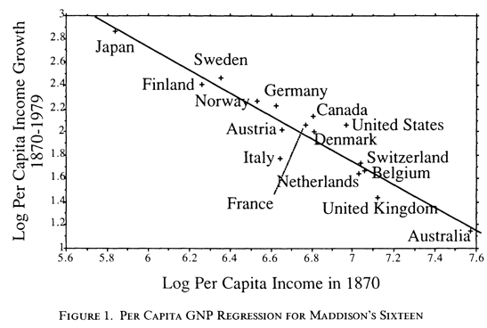
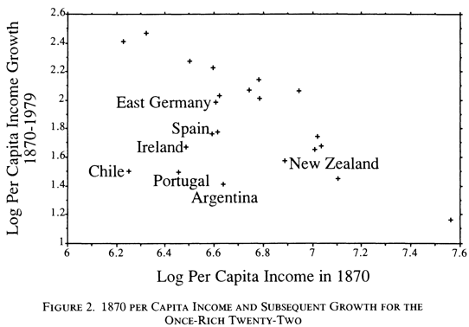
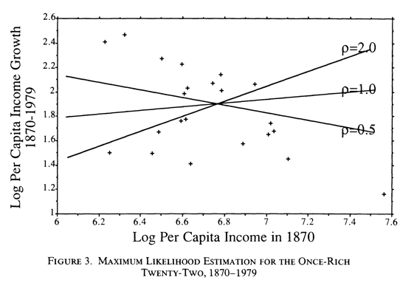
4.4.1. Convergence’s Absence
Expected convergence:
Economists have always expected the "convergence"of national productivity levels
The theoretical logic behind this belief is powerful.
Will Baumol expressing conventional wisdom
  Personal biography
Do these two things:
Remove sample selection
Account for errors in variables in the past
Then any convergence tendency in the data disappears
This is much stronger than “there is divergence because some countries had good institutions, and others could not learn”
This is, rather: “even if you have good institutions at one particular point in time, it can still get very messed up”
But perhaps the once-rich twenty-two contained some countries that were rich by accident, and thus should not be in a sample of countries that had successfully developed “modernizing institutions”?
Notes:
Expected convergence:
Economists have always expected the "convergence"of national productivity levels
The theoretical logic behind this belief is powerful.
Will Baumol expressing conventional wisdom
Personal biography
Do these two things:
Remove sample selection
Account for errors in variables in the past
Then any convergence tendency in the data disappears
This is much stronger than “there is divergence because some countries had good institutions, and others could not learn”
This is, rather: “even if you have good institutions at one particular point in time, it can still get very messed up”
But perhaps the once-rich twenty-two contained some countries that were rich by accident, and thus should not be in a sample of countries that had successfully developed “modernizing institutions”?

Slide 7
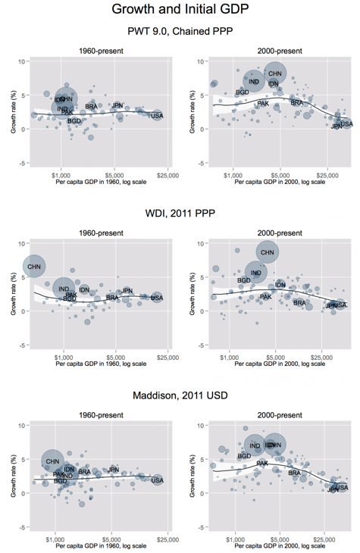
There Was No Convergence Tendency
Patel, Sandefur, and Subramanian: “Our basic point doesn’t even require regressions”
But they do them nonetheless
Their argument is that there did not use to be convergence—back before 1990 there was not: there was divergence
But something changed between 1990 and 2000
And since 2000 there has been strong “convergence”
  There is every reason to think—hope—that this strong convergence will continue into the future
  What is this post-2000 convergence due to? We can think about that at the end…
Notes:
Patel, Sandefur, and Subramanian: “Our basic point doesn’t even require regressions”
But they do them nonetheless
Their argument is that there did not use to be convergence—back before 1990 there was not: there was divergence
But something changed between 1990 and 2000
And since 2000 there has been strong “convergence”
There is every reason to think—hope—that this strong convergence will continue into the future
What is this post-2000 convergence due to? We can think about that at the end…

Slide 8
What Caused Post-2000 Convergence?
Patel, Sandefur, and Subramanian do not say:
Let’s think about this…
What are the obvious candidates?
  The Great Recession and the Anemic Recovery
    Institutional dysfunction in the Global North
    Austerity and a failure to prioritize a return to full employment and growth
  The coming of the value-chain economy
    No longer having to keep your blue-collar assembly-line workers close to your engineers, your executives, and your brand creators
  Modern information and communications technologies more generally
    The internet
    Reduced distance in general—transoceanic airplane flights at a greatly increased pace
Notes:
Patel, Sandefur, and Subramanian do not say:
Let’s think about this…
What are the obvious candidates?
The Great Recession and the Anemic Recovery
Institutional dysfunction in the Global North
Austerity and a failure to prioritize a return to full employment and growth
The coming of the value-chain economy
No longer having to keep your blue-collar assembly-line workers close to your engineers, your executives, and your brand creators
Modern information and communications technologies more generally
The internet
Reduced distance in general—transoceanic airplane flights at a greatly increased pace

Slide 9
4.5.1. Development of Underdevelopment
As of the 1870 watershed-crossing, had the Industrial Revolution raised the standard of living or lightened the toil of the working class in England, the country at its center?
No.
Why not? Malthusian forces—population explosion & thus smaller farm sizes.
Pace of technological and organizational change not fast enough to raise incomes high enough to force the demographic transition.
Hence importance of 1870: our h goes from 0.44%/yr to 2.06%/year, globally, and sticks there since
  (Until now?)
Principal cause of the speed-up? The modern corporation and its industrial research labs that made routine the process of developing and then implementing new productive ideas.
  (Was this baked in the cake by the Industrial Revolution? Or could this have been bobbled?)
Assisting: globalization:
  Globalization of goods through trade using railroads and iron-hulled steamships
  Globalization of people through migration using railroads and iron-hulled steamships
  Globalization of communications using the telegraph
Yet: DIVERGENCE, BIGTIME
Notes:
Somehow, at least the first century of the post-1870 Modern Economic Growth era has also seen DIVERGENCE, BIGTIME. While economic and political-economic processes have seen the global north develop massively, they have also seen the emergence of enormous income and productivity gaps between the global north and the global south. While the global north has been developed, the global south has been underdeveloped—has grasp of a lot smaller a fraction of the human technological cornucopia H than it had hold of in 1870, or, indeed, at any time earlier.

Slide 10
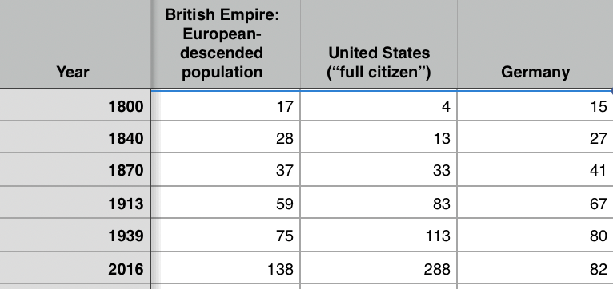
Migration 1870-1914
100 million people left their continents of origin between 1870-1913—70 million of them permanently:
9 days from Liverpool to New York: it had taken a month in 1800
1.5 month’s wages for an unskilled European worker—to double your pay, and your children’s pay
50 million from Europe, 50 million from Asia
Migration and global inequality
  The development of underdevelopment in the global south can be understood only as a consequence of these waves of migration
Migration and exceptional America
  Only America’s welcoming of migration gave it the demographic heft to be the world’s 20th century superpower
Notes:
During the half-century before World War I, 100 million people left their continents of origin—70 million of them permanently. They did so because of the iron-hulled screw-propellered ocean-going steamship. It made it profitable and possible for 50 million from Europe and 50 million from Asia changed continents. This was an absolute bonanza for those who made the voyage. This was a relief for those back at home who found resources less crowded and scarce. But this was also a principal source of global inequality—a reason why the global south found itself as a whole leveled down to the Chinese and Indian standard, for China and India were then in the down, poverty-stricken phase of the Malthusian cycle. The development of underdevelopment in the global south can be understood only as a consequence of these waves of migration.

Slide 11
Migration from Asia Channeled to the Tropics
To the tea plantations of Ceylon, the rubber plantations of Malaysia, & c.:
This mattered
Migration out did not raise wages much in the migration-source economies of China and India
  They were so large in population
  Emigration was but a drop in the bucket
Did migration lower relative wages in tropical-zone recipient economies? Yes.
  Plus it lowered relative wages in tropical-zone economies that never saw a migrant.
  British capital, Brazilian-stock rubber plants, and labor imported from China went to Malaya
  There it could and did put heavy downward pressure on the wages in Brazil of rubber tappers who did not know there was such a place as Malaya
Notes:
The flow of migrants out of China and India was directed to the tea plantations of Ceylon or the rubber plantations of Malaysia. And British capital, Brazilian-stock rubber plants, and labor imported from China to Malaya could and did put heavy downward pressure on the wages in Brazil of people who did not know there was such a place as Malaya.

Slide 12
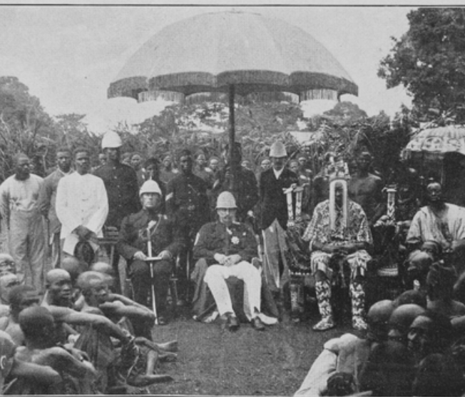
Underdevelopment & Empire
The standard package for successful development;
  Market-promoting government;
  Building railroads, canals and ports;
  Chartering banks for commerce and investment;
  Establishing mass education
  Imposing smart tariffs on those manufactured imports that would in the short-run crowd out production and thus the creation of the communities of engineering practice
Colonial masters would not allow the standard package
Nevertheless, progress:
  Even outside of the global north the world was far richer in 1950 than it had been in 1800
  The center-of-gravity of what now is the global south was at a living standard of $2 a day in 1800s
  $2.25 by 1870
  $3.50 by 1913.
  But still about $3.50 by 1950.
However, there were a number of economies that seemed to be taking advantage of opportunities:
  Japan
  Those parts of Latin America that escaped internal colonization by landed and bureaucratic elites
But the gap between global north and global south had grown: from 2.5 to 1 in 1800 to 4 to 1 in 1870 and 1913, and to 7 to 1 by 1950.
Notes:
Stable market-promoting government; building railroads, canals and ports; chartering banks for commerce and investment; establishing mass education; and imposing tariffs on those manufactured imports that would in the short-run crowd out production and thus the creation of the communities of engineering practice in those modern industries in which long-run comparative advantage lay—those were what Robert Allen and others have judged to have been the essentials for stepping on to the escalator of prosperity that was post-1970 modern economic growth.
But for the colonized in Asia and Africa before World War II that was not a possibility: they could not do that. Their colonial masters had little interest in and provided no support for such policies. And the competition that their natural resource products and their workers faced from the products and workers or extremely low-wage India and China crippled the wealth of a middle class that might otherwise have provided demand to spur industry, and made globalization more the foe than the friend of economic development.
How about Latin America, which had achieved independence from Spain and Portugal early in the 1800s? How did they do before World War II? Mexico, Columbia, Peru, Brazil, and the others suffered, by and large, from what one might call internal colonialists: a landed elite privileged by property ownership and Iberian descent that feared an educated proletariat, loved foreign-made manufactures, and had Iberian-derived legal systems that did not mesh well with the needs of commerce and industry.
Do not get me wrong: outside of the global north the world was far richer in 1950 than it had been in 1800, and richer by a substantial margin. If the center-of-gravity of what now is the global south was at a living standard of $2 a day in 1800s and $2.25 by 1870, it was about $3.50 by 1913. But, dragged down by China in war and revolution and by an India that had been heavily hit by the disruptions of trade that came with the Great Depression and then war, it was still about $3.50 by 1950. But there were a number of economies that seemed to be taking advantage of opportunities: Japan had already joined the industrial powers. Those parts of Latin America that escaped internal colonization by landed and bureaucratic elites were looked to be catching up: Chile, Argentina, Uruguay, and southern Brazil still looked more like a cross between an Australia and an Italy than like the externally or internally colonized. Venezuela had its oil boom. Cuba and Costa Rica showed signs of escape. Iran, Iraq, Lebanon, Egypt, Morocco, and Algeria; South Africa, Kenya, Zambia, Ghana, and Nigeria; Mexico and Peru all formed a global middle stratum.
But the gap between global north and global south had grown: from 2.5 to 1 in 1800 to 4 to 1 in 1870 and 1913, and to 7 to 1 by 1950.

